Slide 1
Grids, Clouds and the Social Sciences
Rutger Kramer – Oct 21st, 2010 – NEERI Vienna

Slide 2
Data Archiving & Networked Services
Humanities & Social Sciences
Main aims
Archival of Research Data
Building the Research Data Infrastructure
Departments:
Archiving
Infrastructure
Software Development

Slide 3
Previous work
CESSDA PPP Report
“Possibilities of Grid technology”
Grids
Clouds

Slide 4
Use cases
Researcher performing cross national comparative research
Data Archivists harmonizing datasets
Analysis of sensitive (micro) data
Survey producers creating new instruments (surveys, questionnaires)

Slide 5
What does it say?
Report is helpful
Gives a clear overview of grid and cloud possibilities and drawbacks
But
No clear conclusion for either technology
Leaves out innovative possibilities, due to focus on current use-cases,
Does not show relation between use-cases, i.e. the infrastructural overlap,

Slide 6
Infrastructure
Networks
Services
Variable repositories
Applications
Data Portals
Automatic Transcription
Collaboration systems
Persistent IDs
Single Sign On
Survey Construction/ Management
Data Storage
Search / Discovery
Visualization
Enhanced Publications
Exchange protocols

Slide 7
Infrastructure
Networks
Services
Variable repositories
Applications
Data Portals
Automatic Transcription
Collaboration systems
Persistent IDs
Single Sign On
Survey Construction/ Management
Data Storage
Search / Discovery
Visualization
Enhanced Publications
Exchange Protocols

Slide 8
From an applications perspective:
There is no real issue with the currently available infrastructural technologies
Social Sciences could work with
Grids
Clouds
C/S
Hybrid forms
Etc.

Slide 9
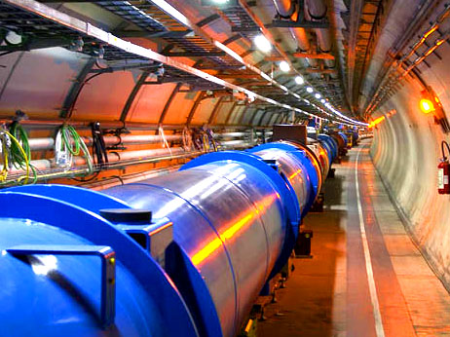
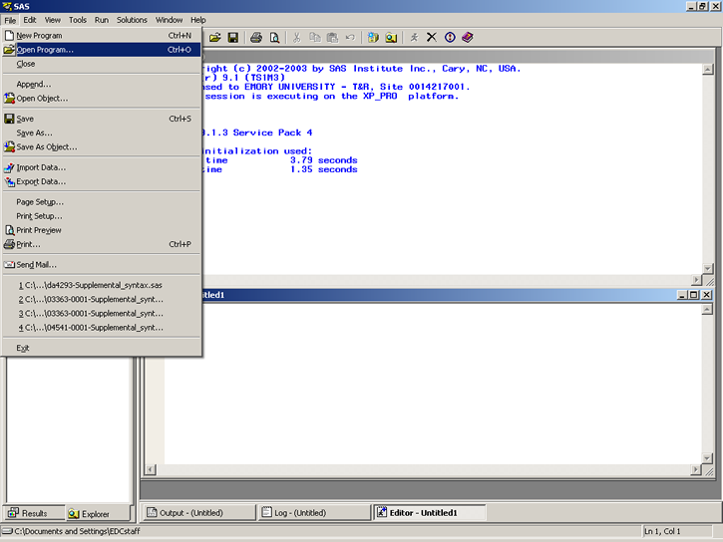

Slide 10
So why consider it at all?

Slide 11
It’s not about the sciences
We’re working on:
Collaboration across disciplines, organizations and nations
Sharing research and data
Sharing resources and services
This, by itself, is not discipline specific

Slide 12
It’s about coordination
Coordination of efforts is paramount
Developing standards for registries and information interchange
Distributing effort for service development (visualization, transcription, etc.)
Pooling resources for persistent storage
Common platform is needed

Slide 13
Grid is a common platform
It’s already there
Single Sign On scheme
Sharing resources
Digital collaboration
It needs to be enhanced / adapted
Applications need to be built on top of it

Slide 14
How to proceed?
ESFRI Projects:
Commit to one common platform
Together and unanimously
Grid is already there
EGEE did a lot of the tedious stuff already
EGI is eager to help
Clouds can be deployed on or alongside grid
Building a new platform will be costly and hazardous

Slide 15
Continue with current work
Building communities
Acquiring use-cases
Inspiring new research
As for chickens and eggs:
Fry the egg and eat the chicken

Slide 16
Thank you
rutger.kramer@dans.knaw.nl
images taken from
http://atlas.ch/atlas_photos/selected-photos/lhc/LHC_hall_1.jpg
http://data.lib.uci.edu/danalys/images/ICPSR-SAS/sasxpt_05.png

