Slide 1
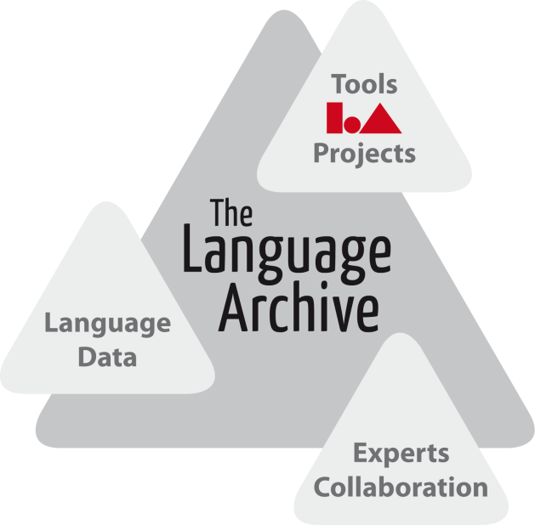
Grids and Clouds - Humanities Research
Peter Wittenburg, Daan Broeder
The Language Archive – Max Planck Institute for Psycholinguistics
Nijmegen, The Netherlands
(thanks to Dirk Roorda as a great source of inspiration)

Slide 2
generic terms
grids can be esthetic, but ...
a regular structure with lots of
cross-over points
predictable, solid, efficient,
straight, etc.
seems to be invention of human
mind or?
ideal for technology
clouds can be beautiful, but ...
not transparent, unpredictable,
"fishy", etc.
rather amorphous structure, rather
opaque
seems to be invention of nature or?
not ideal for technology

Slide 3
TLA
IT branding of terms
Grid
emerged from research domain
scalability by "distribution"
distributed (unlimited) computing on heterogeneous nodes
easy job distribution incl. a solution for data exchange
integrating different legal entities
world-wide investments for many years
investigation of computational methodologies (-> semantic Grid)
software stack: GTK, gLite, UNICORE, ARC
commitment to open source
huge base on expert knowledge

Slide 4
TLA
IT branding of terms
Cloud
emerged from business with clear goal to make money
scalability by "concentration"
big compute and storage fabric
one entry point with invisible internal structure
one legal entity
thus Grid is not a very interesting approach for industry
software stack: Amazon, MS, Google, etc
simple to use offers (incl. easy sw test and deployment)

Slide 5
Where is the humanities researcher?
humanities is moving towards eHumanities - so phase of changes
actually humanities researchers are interested in easy-to-use and
persistent services and some of their characteristics
are we really interested in motor types of cars?
humanities research characteristics (some)
highly unpredictable (lack the regularity as for HEP)
in general small projects accessing scattered resources
sustainable data - not just for 10 years - it's about human history
increasingly data oriented (but not EXA-Bytes, but complexity)
mostly small data - linked by semantics
highly service oriented in a distributed setting
must be very simple to use
must be inexpensive (who is ready to pay 75 developers)

Slide 6
humanities characteristics
what is (not) relevant
sharing is still a hard problem - sometimes for good reasons
there is a different relation to his/her data - sometimes possessive
"secondary" data is result of research efforts
there is often a lot of IPR involved
need to remain sensitive
mixed manual + automatic annotation - the latter often being small
so many corrections and interventions needed
do we know how to automatically handle semantics - still a huge gap
virtual collections are important
how to find resources in a scattered landscape
Teraflop computing in general not an issue yet (mind simulation?)

Slide 7
common needs - DARIAH/CLARIN
data archiving and curation, i.e. integrity, authenticity, visibility,
accessibility, interpretability, etc.
fine grained authentication and authorization based on trust and
simple mechanisms
single identity guaranteed by home institution
single sign one - how else efficient operation
web services operating in scattered landscape
with rich services for different media and data types
offering various knowledge types
better availability and use of advanced tools
smart indexing and content access in addition to metadata

Slide 8
who will be involved?
Trust
Data Curation
Data generators
Users
User functionalities
Data capture & transfer
Virtual Research Environments
CLARIN, DARIAH, DOBES etc
Data discovery & navigation
Workflow generation
Annotation, Interpretability
Community Support Services
e-Infrastructure
Common Data Services
Safe & persistent storage
Identifiers, Authenticity, Workflow execution, Mining
Shared Responsibility as future solution
Can we omit the middle layer (centers, VCC)?

Slide 9
did Grid/Cloud take up in humanities?
given all the characteristics is it surprising that
Grid not "yet" practical in SSH
humanities are mostly "out of scope" for the Grid
humanities even don't know that they are using Clouds
(one could say that this is positive)
need to be fair
Grid/Cloud never claimed to solve many of the essential problems
there are projects of course
TextGrid in D is a very good example
very interesting framework
Grid mainly used for data store and not computation aspect
many well-trained young people (hope some will stay in Hum)

Slide 10
about procedures
Physics at the source of the Grid and sure a couple of excellent ideas
was seen as the blueprint to solve many IT problems
great hype for young and old IT-ers + lots of funds
Grid was in - not using Grid and you were out
at a certain moment the usual circle is in place
issue of legitimating ongoing investments
hunting for use cases "show me your use case - we'll solve it"
when do we understand: it's not about use cases and some IT
it's about getting a discipline ahead
(effort, trust, culture, efficiency, etc)
two track approach not bad
top-down IT based suggestions - may become hampering factor
bottom-up driven developments - re-inventing, naive, etc.
good: both deliver educated experts
they will design the next wave of solutions
but only if sensitivity is not lost

Slide 11
relevant questions
what can Grid/Cloud solve for humanities?
sure these technologies will be used if robust, simple enough, etc.
who cares at the end - it's the service that counts?
what does it cost?
humanities departments don't have large budgets
humanities departments don't have large IT staff
in principle: Cloud sounds to be cheaper
are there strange side effects?
yes - Cloud associated with commercial offers
if I store data - who owns the data
if I store data - where is it copied
if I store data - how long can I access it
is AMAZOOGLE for data what the Elseviers are for publications?
but Cloud does not have to be commercial

Slide 12
conclusions
do I have some conclusions?
not really
perhaps one inspired by Steve's talk
"do we know how to make optimal use of all the knowledge
collected in a decade of Grid development?"
should think about it - but it costs so much time and energy

Slide 13
End
Thanks for your attention.

Slide 14
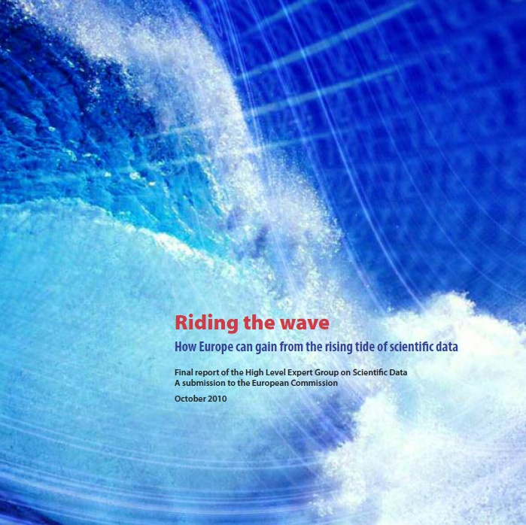
Are we alone with concerns?
HLEG 20 years strategy for Europe
focusing on data

