Slide 1
E-Infrastructures for Data Intensive Science
Bob Jones, CERN
NEERI 2010 Networking Event for the European Research Infrastructures Vienna, 21 October 2010
1
Notes:
1

Slide 2
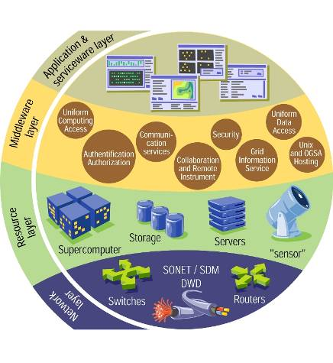
e-Infrastructure

Slide 3
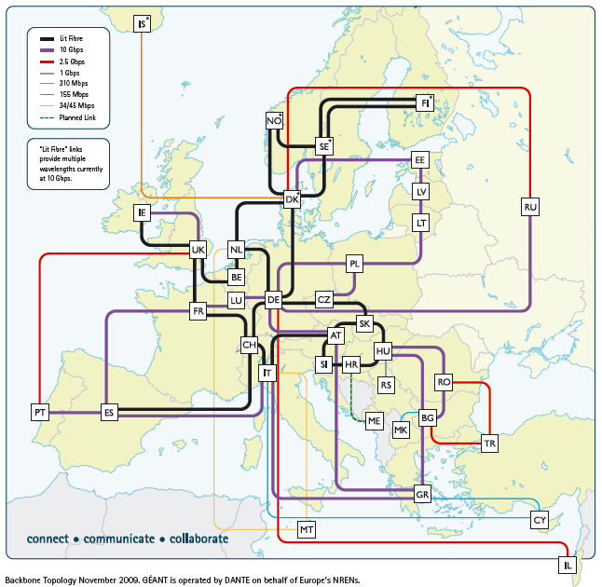

Slide 6
slide by Thomas Eickermann
Notes:
The first PRACE machine has been installed in Julich: JUGENE (IBM Blue Gene/P) - total of 72 racks with 294,912 processors, peak performance of 1 petaflop. Main memory 2 Gbytes/node. Can only store data for 90 days. PRACE expects to install another 4 machines (different suppliers/architectures) around Europe (roughly 1 per year) to ensure Europe has access to the latest HPC machines for the 5 years to come.
http://www.prace-project.eu/hpc-access/page-7

Slide 7
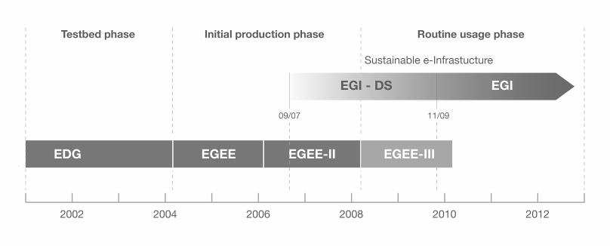
European Grid Infrastructure
European Data Grid (EDG)
Explore concepts in a testbed
Enabling Grid for E-sciencE (EGEE)
Moving from prototype to production
European Grid Infrastructure (EGI)
Routine usage of a sustainable e-infrastructure

Slide 8
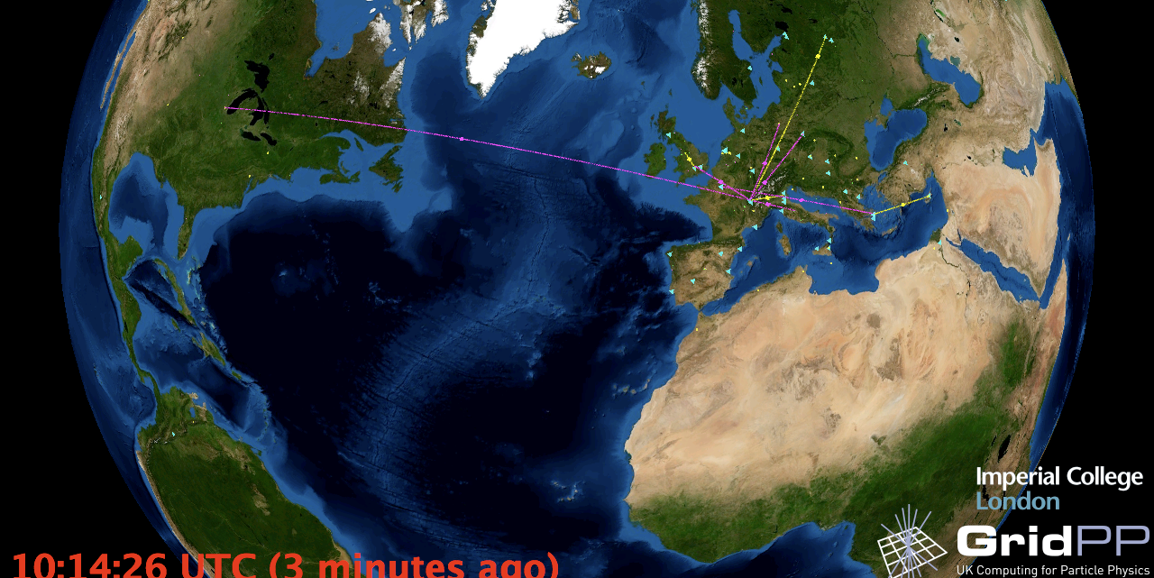
European Grid Infrastructure
Archeology
Astronomy
Astrophysics
Civil Protection
Comp. Chemistry
Earth Sciences
Finance
Fusion
Geophysics
High Energy Physics
Life Sciences
Multimedia
Material Sciences
…
>315 sites in 52 countries
>240,000 CPU cores
>40 PetaBytes disk, >61 PB tape
>10,000 users
>15 million jobs/month

Slide 9
Forum for the discussion of principles and practices to create synergies for distributed e-Infrastructures
Goal: seamless interoperation of leading e-Infrastructures serving the European Research Area
Focus: needs of the user communities that require services which can only be achieved by collaborating e-Infrastructures
Current membership:
EGI
DEISA & PRACE
Terena & GEANT
The forum recognises the importance of data access and management and is seeking to add a member specialising in service provision in this area for multiple research communities
Offers a way of interacting as a whole with user communities of a multi-national nature that are interested in making use of the e-Infrastructures
http://www.einfrastructure-forum.eu/
9
Notes:
9

Slide 10
Workshops at which EEF has gathered (Sept’09 - Apr’10) further information about ESFRI project requirements:
Total of 28 ESFRI projects consulted, including 5 from the Social Sciences and Humanities sector:
CLARIN – Common Language Resources and Technology Infrastructure Survey
ESS - The European Social Survey
DARIAH - Digital Research Infrastructure for the Arts and Humanities
SHARE - Survey of Health, Aging and Retirement in Europe
CESSDA – Council of European Social Science Data Archives
Report published: http://www.einfrastructure-forum.eu/documents/EEF-report

Slide 11
Identified SSH project requirements:
Data archiving and curation
Flexible repository system
Sensitivity of the data calls for a fine grain Authorization and Authentication system
Ease of access to all e-infrastructure resources via Single Sign On
Access to grid and cloud computing facilities for the processing of stored data
Education and training for e-infrastructure usage

Slide 12
Questionnaire to Communities
How are users authenticated?
Which credentials are in use?
How is the user vetting done?
Is there a link to national identities?
Which types of resources are in use? How are users authorized?
Resources access through Grid?
Resources accessed without Grid?
Where does project want to be in ~5 years?
Are users and resource owners happy with current authN and authZ schemes?
Slide by John White (HIP)

Slide 13
CLARIN (1/2)
Dieter Van Uytvanck, MPI for Psycholinguistics
Aim:
Provide language resources and technologies for humanities and social sciences
Typical use-case:
On basis of browsing catalogues and/or searching through data create a virtual collection and process it through work flows using web services

Slide 14
CLARIN (2/2)
Long term AA objectives:
Rely on user’s home organization of national AAIs for establishing trust → SAML, Shib
CLARIN as legal entity to sign contracts with national identity federations
Rely on eduGAIN to provide trust between national AAIs
Issues raised:
License acceptance must be solved (special license service)
Multi-level WAYFs and attribute release consent confusing for the user

Slide 15
Data Management
DC-net survey: How to use existing e-infrastructures by Digital Heritage organisations and specify requirements for new services:
knowledge of data storage and management is often not available at DCH organisations
- physical storage/backups
- where to locate the data regarding to computing needs
- responsibility/ownership of data
- identity management, secure access

Slide 16
Requirements
Standards and metadata
Automatic extraction of knowledge
Protocols for interoperability
Empowered search engines for complex data
Advanced repositories architectures
Rights management
Use and re-use of content
Advanced services for collections management
Multilingualism
Linked data and persistent identifiers
Material by Rosette Vandenbroucke, SIST-DWTI, Belgium

Slide 17
Grids, clouds, supercomputers, etc.
Grids
Collaborative environment
Distributed resources (political/sociological)
Commodity hardware (also supercomputers)
(HEP) data management
Complex interfaces (bug not feature)
Supercomputers
Scarce
Low latency interconnects
Applications peer reviewed
Parallel/coupled applications
Traditional interfaces (login)
Also SC grids (DEISA, Teragrid)
Many different problems:
Amenable to different solutions
No right answer
Clouds
Proprietary (implementation)
Economies of scale in management
Commodity hardware
Virtualisation for service provision and encapsulating application environment
Details of physical resources hidden
Simple interfaces (too simple?)
Volunteer computing
Simple mechanism to access millions CPUs
Difficult if (much) data involved
Control of environment ➔ check
Community building – people involved in Science
Potential for huge amounts of real work
Consider ALL as a combined e-Infrastructure ecosystem
Aim for interoperability and combine the resources into a consistent whole
Keep applications agile so they can operate in many environments
Slide by Ian Bird

Slide 18
Grid Services Over Cloud Resources
users
Grid Resource Center
Grid Services
Cloud API
StratusLab
Distribution
Private Cloud
Slide by C.Loomis
http://stratuslab.eu/
Public Clouds

Slide 19
Clouds - Questions to keep in mind
Data is precious to researchers
Are they prepared to trust it to someone else?
SSH does not get its data from scientific instruments but rather corpus of material to which it adds value with annotations, establishing relationships etc.
Public vs private clouds
Location independence: means you may not know where data is stored and hence under which jurisdiction it is held
Public : Terms and conditions of service (SLA etc.) vary*
Interoperability
Can you link (build chains/workflows) between different cloud systems?
Can you use the same identity across different cloud systems?
* Bradshaw, Simon, Millard, Christopher and Walden, Ian, Contracts for Clouds: Comparison and Analysis of the Terms and Conditions of Cloud Computing Services. Queen Mary School of Law Legal Studies Research Paper No. 63/2010. Available at SSRN: http://ssrn.com/abstract=1662374

Slide 20
The Ecosystem of “Inter-Cloud” Trust Management
University
Campus
Dept
Government Cloud
University
Trust
Relationships
Agency
Agency
Campus
Dept
Dept
Dept
Corporation
Dept
Corporation
Dept
Need for:
Federated identity models
Role-based authorization
Virtual organizations
Something like the IGTF
Commercial
Cloud
Commercial
Cloud
Public
Public

Slide 21
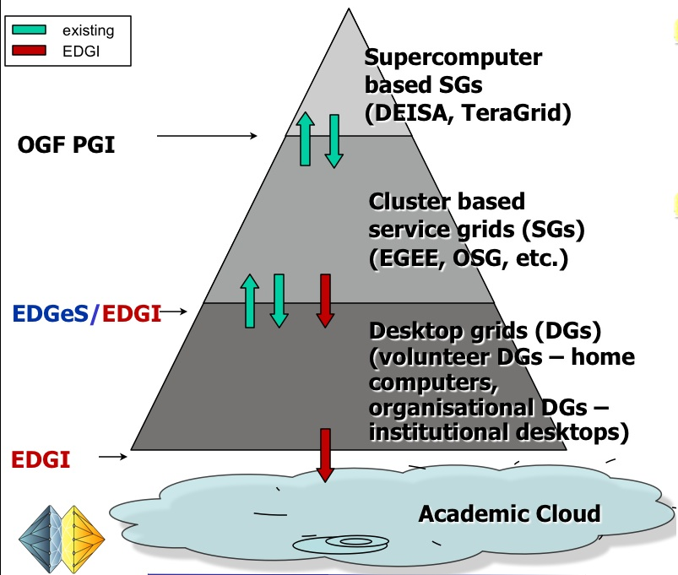
Slide by EDGI project http://edgi-project.eu/

Slide 22
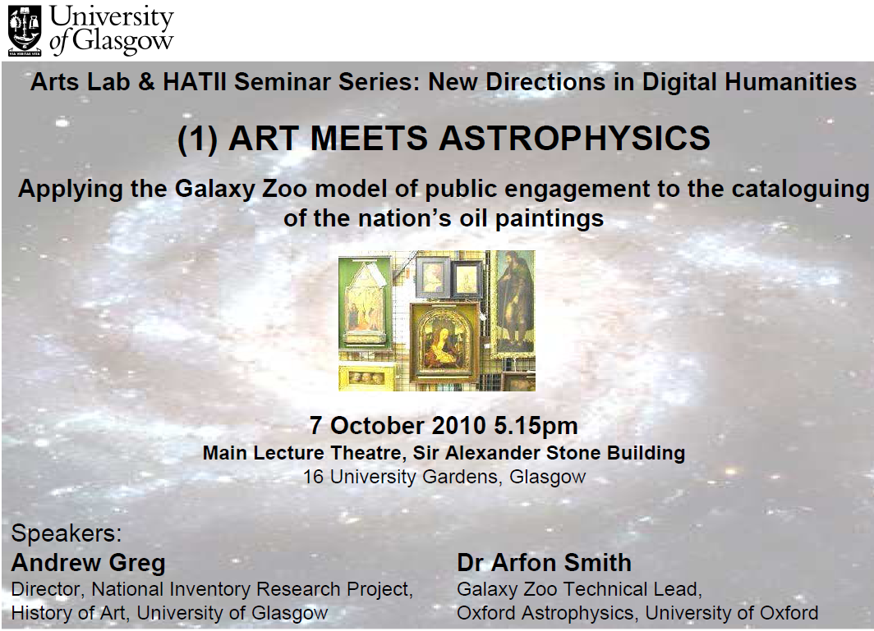

Slide 23
EEF thinks it can address some of these requirements by harmonising existing services so users get a consistent access to all e-infrastructure resources:
Single sign-on – ensure same identify can be used across network/HPC/grid/clouds by harmonising policies for Authentication, Authorization and eventually Accounting and Auditing
needs technical developments and a review of policies by all parties
Virtual organisations – harmonise support across HPC/grids/clouds
review policies and potentially some middleware developments needed
Security incident handling
cooperating security incident response group
Notes:
The German textgrid project offers single sign-on

Slide 24
Harmonising existing services (2/3):
Persistent storage
work with middleware & data mgmt providers so PIDs are supported
User support (e.g. interoperating problem handling procedures)
Training & consultancy (contribute to customised training events/material organised by ESFRI projects)
Standards – offer web service interfaces for all relevant e-infrastructure services
will require some developments

Slide 25
Harmonising existing services (3/3):
Workflows – support of access to HPC/grid/network resources (compute & data) by a variety of workflow engines
Global scope – beyond Europe: leverage existing EEF connections and contacts with sister e-infrastructures around the world
cloud / volunteer computing integration
rely on developments by 3rd party projects (StratusLab, EDGI etc.)

Slide 26
Data Management
All ESFRI projects identified data management as a requirement
Large variation in the interpretation of what data management implies
data transfer
data sets (from simple/small files to databases)
ontologies for categorization and structuring of data
metadata
range of data related standards referenced
EEF has an “empty seat” reserved for European data services provider(s)
GRDI2020 identified 12+ existing data related EC projects
It is assumed that the European data services provider(s) would address advanced data management requirements and existing EEF members would ensure such services can exist and be supported in the European context

Slide 27
vision 2030
high-level experts group on Scientific Data
“Our vision is a scientific e-Infrastructure that supports seamless access, use, re-use and trust of data. In a sense, the physical and technical infrastructure becomes invisible and the data themselves become the infrastructure – a valuable asset, on which science, technology, the economy and society can advance.”
High-Level Group on Scientific Data
“Riding the Wave: how Europe can gain from the raising tide of scientific data”
Notes:
27
27

Slide 28
A collaborative Data Infrastructure – a framework for the future
Trust
Data Curation
User functionalities, data capture & transfer, virtual research environments
Data generators
Users
Data discovery & navigation
Workflow generation
Annotation, interpretability
Community Support Services
Persistent storage
Identification, Authenticity, workflow execution, mining
Common Data Services

Slide 30
Next Steps
This is an iterative process –refine the analysis and planning taking into account feedback and additional input
The actions required cannot all be accommodated in the programme of work and resources of the e-infrastructures (DEISA/PRACE, EGI-InSPIRE, GEANT)
A number of recently started projects may be able to contribute (EMI, StratusLab, EDGI etc.)
Defining joint projects with ESFRI and other projects
Must avoid scenario where each ESFRI project adopts a model which is unique and incompatible
Expect to see these joint projects included in proposals to be submitted to the EC (INFSO and RTD directorates) calls in November 2010
Continue to use EEF as a single-point of initial contact for user communities making use of e-infrastructures

